Slide 1

CSE3251
Computer Networks
Dr. Asif Zaman
Professor, CSE, RU

Slide 2
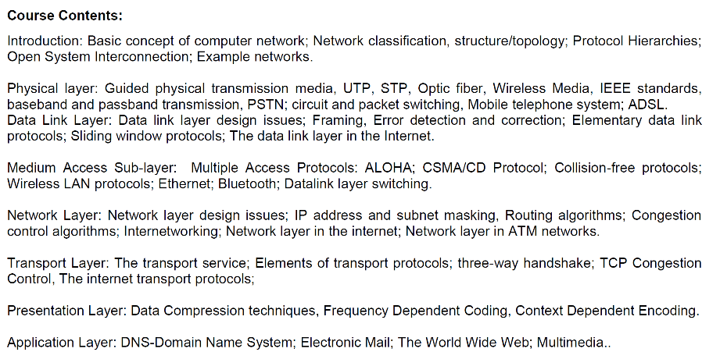

Slide 4
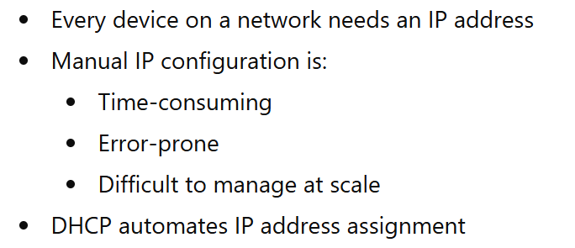
Dynamic Host Configuration Protocol (DHCP)
Why DHCP is Needed?

Slide 5
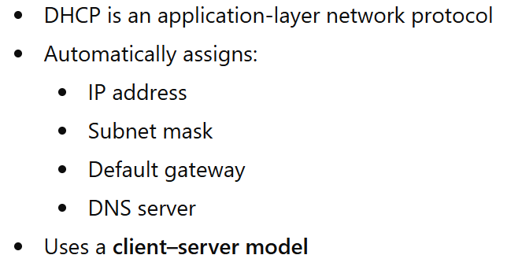
What is DHCP?

Slide 6
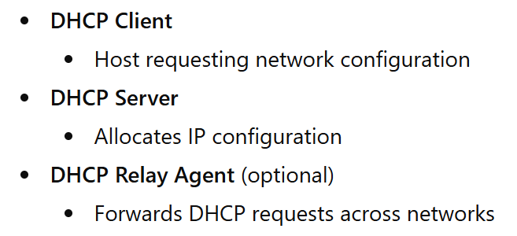
DHCP Components

Slide 7
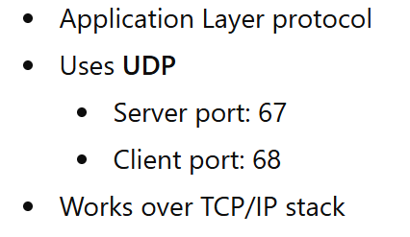
DHCP Uses which Layer?

Slide 8
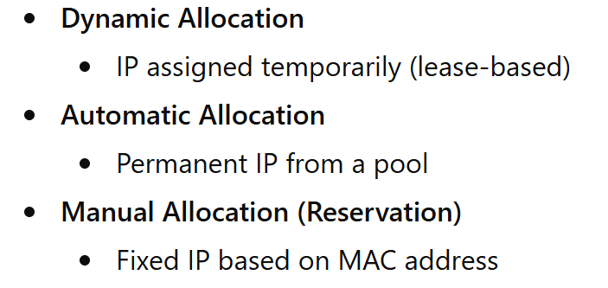
DHCP Address Allocation Methods

Slide 9
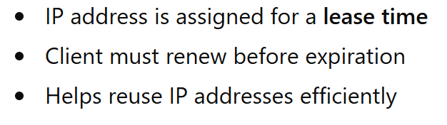
DHCP Lease Concept

Slide 10
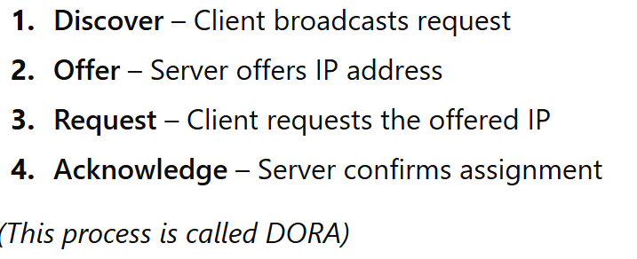
DHCP Message Exchange (DORA)

Slide 11
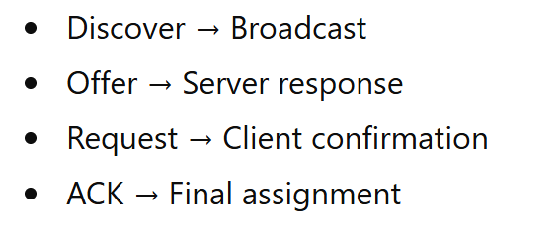
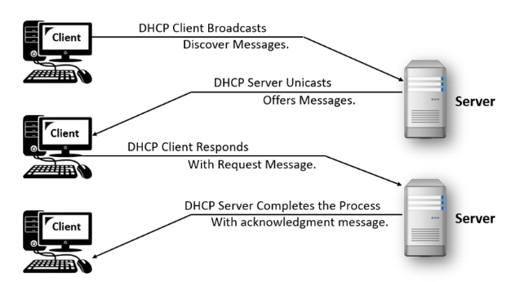

Slide 12
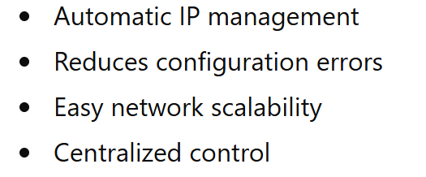
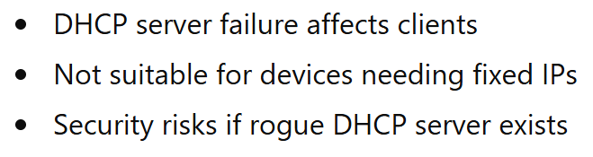
Advantages & Limitations

Slide 13
DHCP vs Static IP
DHCP | Static IP
Automatic | Manual
Temporary | Permanent
Easy to manage | More control
Used in large networks | Used for servers

Slide 14
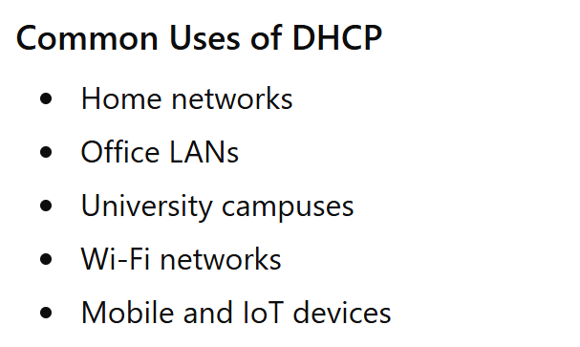

Slide 15
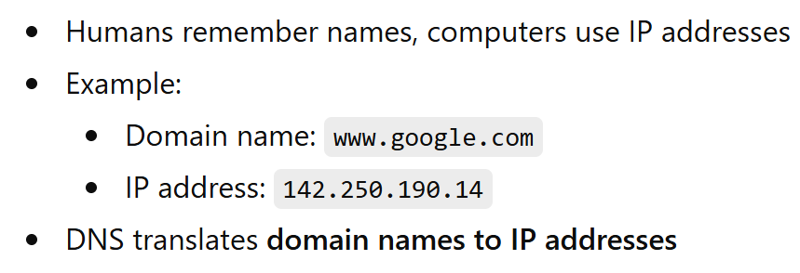
Domain Name System (DNS)
https://www.cloudflare.com/learning/dns/what-is-dns/

Slide 16
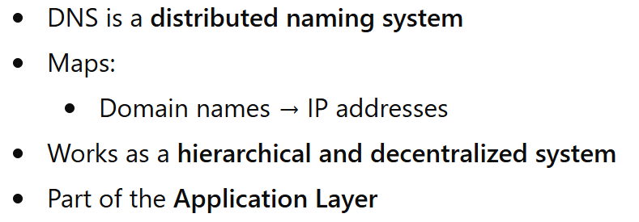
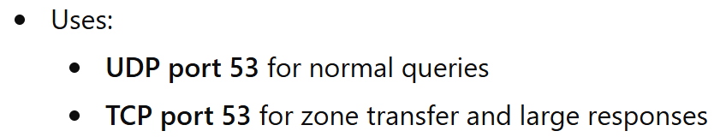
What is DNS
Client side Random Port 1024+

Slide 17
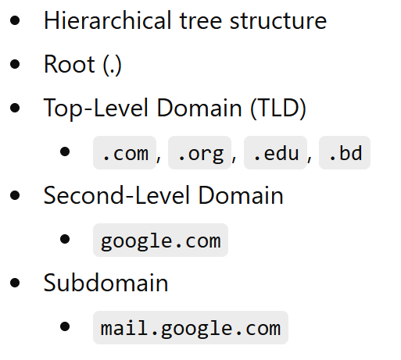
DNS Namespace Structure
The specific name assigned to a device or service (e.g., www or mail). This is often the leftmost label in a fully qualified domain name (FQDN)

Slide 18
Total Character Limit: The entire FQDN cannot exceed 253 characters
Label Limit: Each individual label between dots can have a maximum of 63 characters.
Depth Limit: While 127 levels are theoretically possible, most browsers and networks operate within 3 to 5 levels for practical efficiency

Slide 19
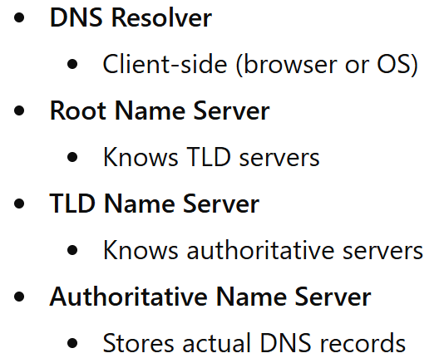
DNS Components

Slide 20
There are 4 DNS servers involved in loading a webpage:
DNS recursor
Root nameserver
TLD nameserver
Authoritative nameserver

Slide 21
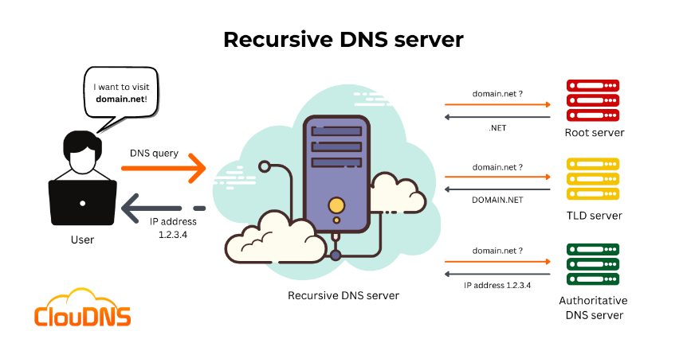
The recursor can be thought of as a librarian who is asked to go find a particular book somewhere in a library.
…a server designed to receive queries from client machines through applications such as web browsers

Slide 22
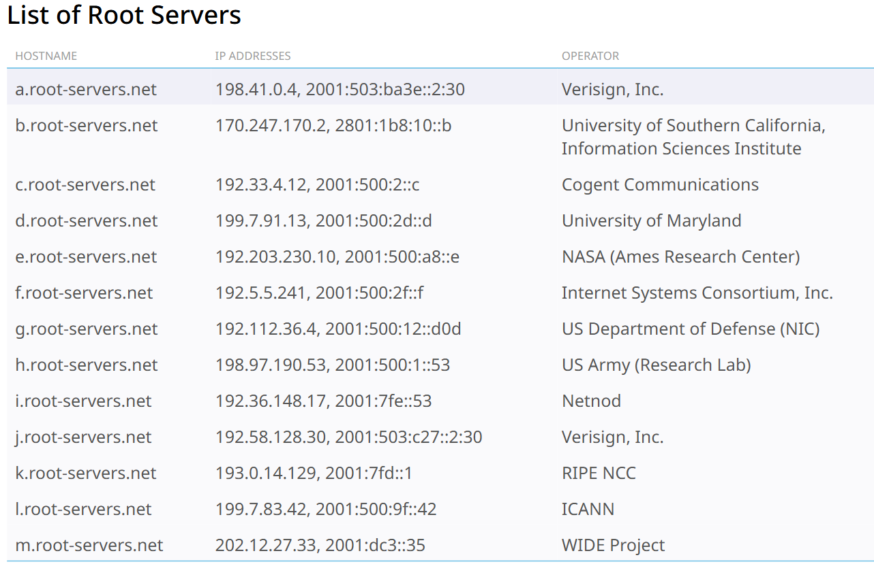

Slide 23
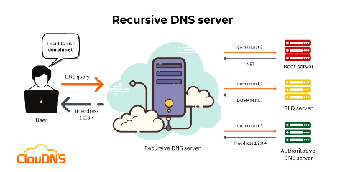
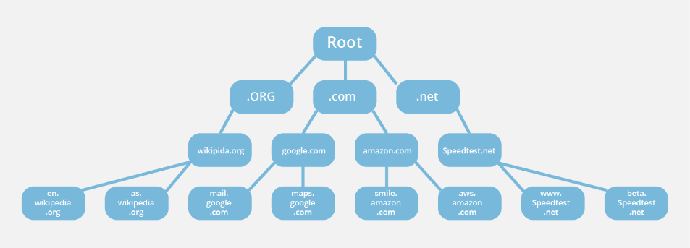
Top Level Domain (TLD) server

Slide 24
What is a TLD nameserver?
Management of TLD nameservers is handled by the Internet Assigned Numbers Authority (IANA), which is a branch of ICANN.
The IANA breaks up the TLD servers into two main groups:
Generic top-level domains: These are domains that are not country specific, some of the best-known generic TLDs include .com, .org, .net, .edu, and .gov.
Country code top-level domains: These include any domains that are specific to a country or state. Examples include .bd, .uk, .us, .ru, and .jp.

Slide 25
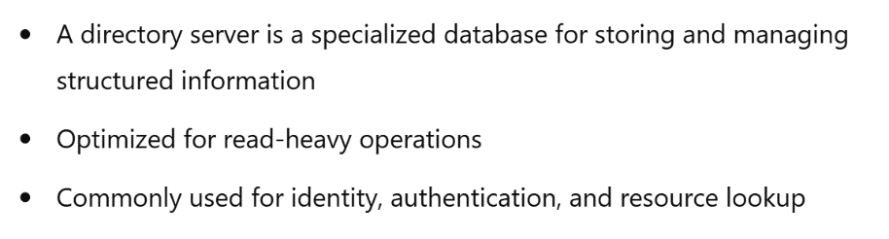
Directory Server
What is a Directory Server?

Slide 26
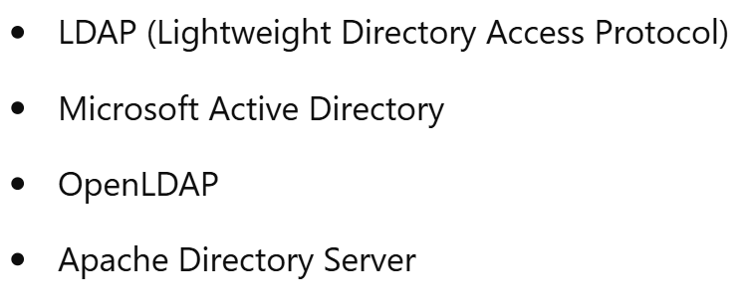
Examples
RADIUS (Remote Authentication Dial-In User Service)

Slide 27
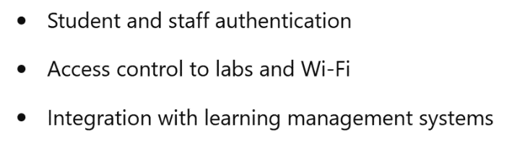
Directory Server in Campus Networks

Slide 28
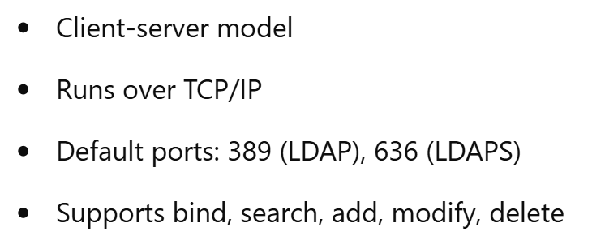
LDAP Protocol Basics

Slide 29
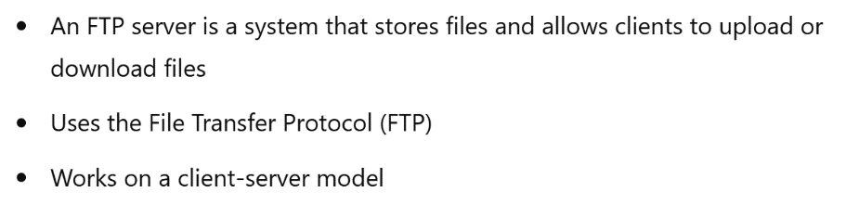
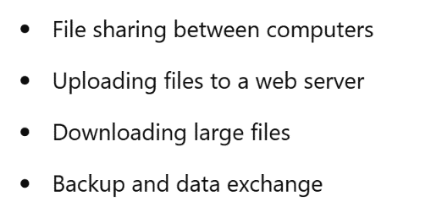
What is an FTP Server?

Slide 30
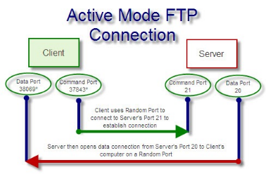
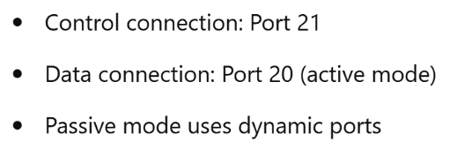
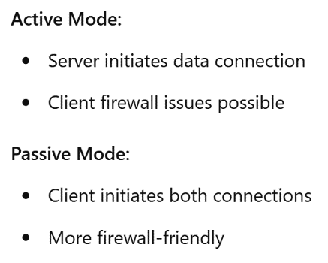
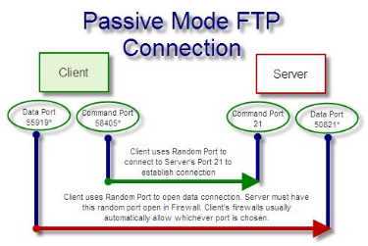
FTP Ports

Slide 31
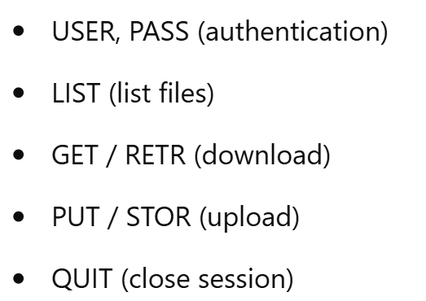
FTP Commands

Slide 32
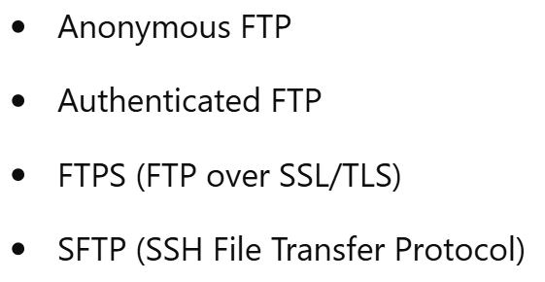
Types of FTP

Slide 33
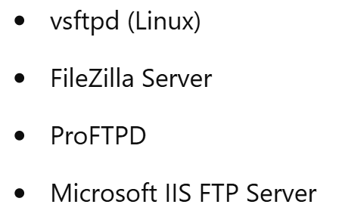
FTP Server Software Examples

Slide 34
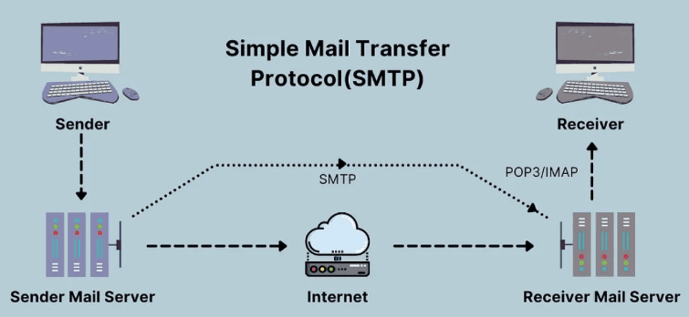
Email Server
Simple Mail Transfer Protocol (SMTP)
To Send Email
Default Port: 25

Slide 35
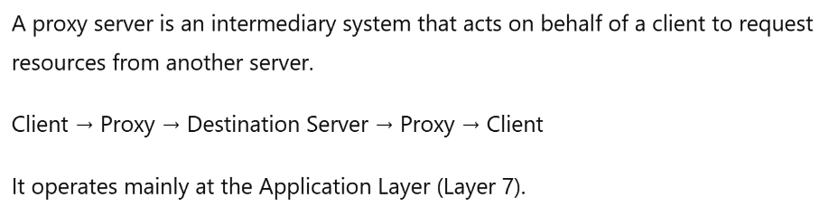
What is a Proxy Server?

Slide 36
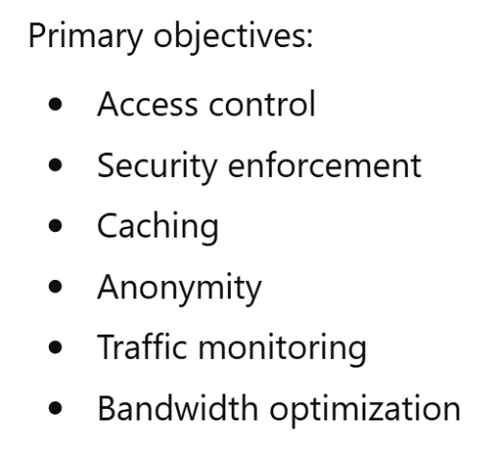
Why Use a Proxy Server?

Slide 37
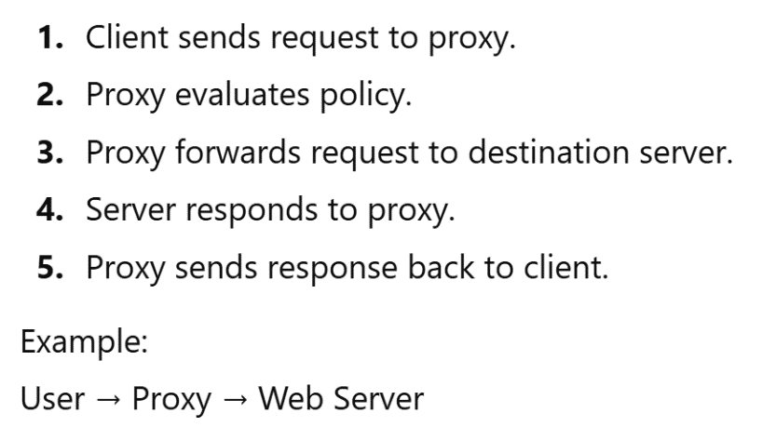
Basic Proxy Communication Flow

Slide 38
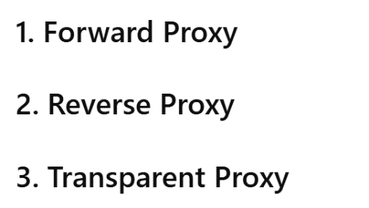
Types of Proxy Servers

Slide 39
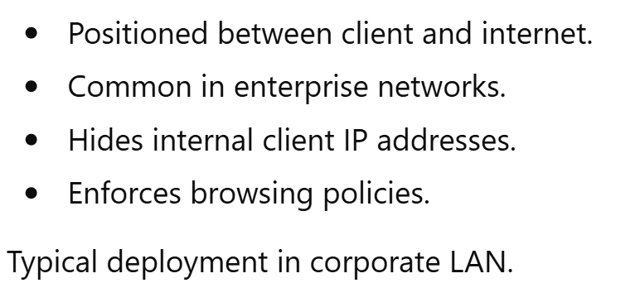
Forward Proxy

Slide 40
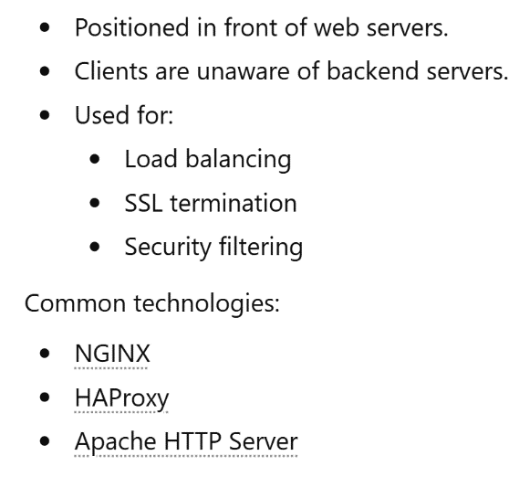
Reverse Proxy

Slide 41
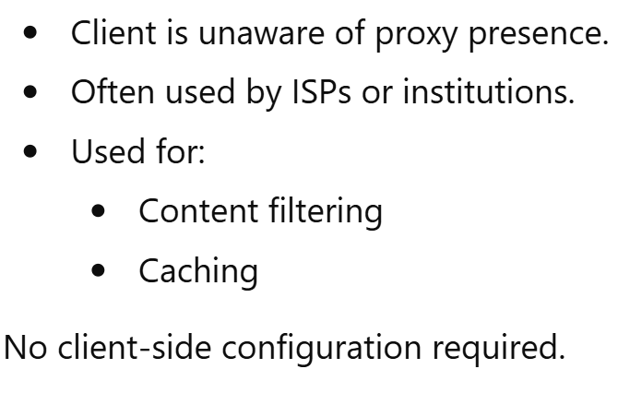
Transparent Proxy

Slide 42
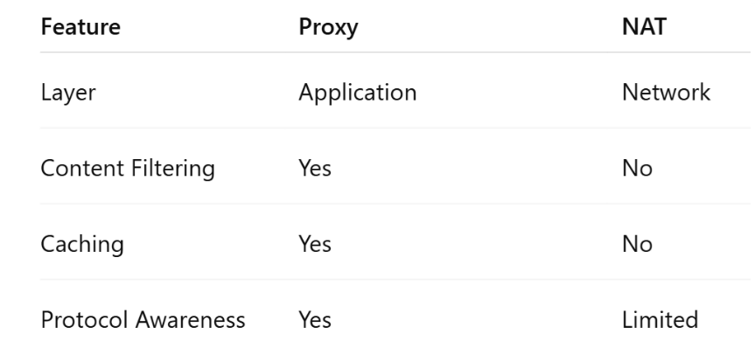
Proxy vs NAT

Slide 43
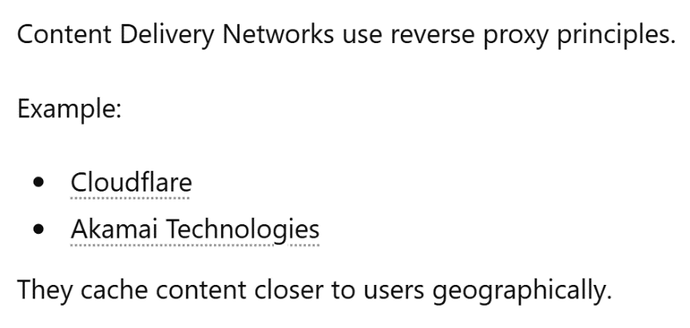
Proxy and CDN Relationship

Slide 44
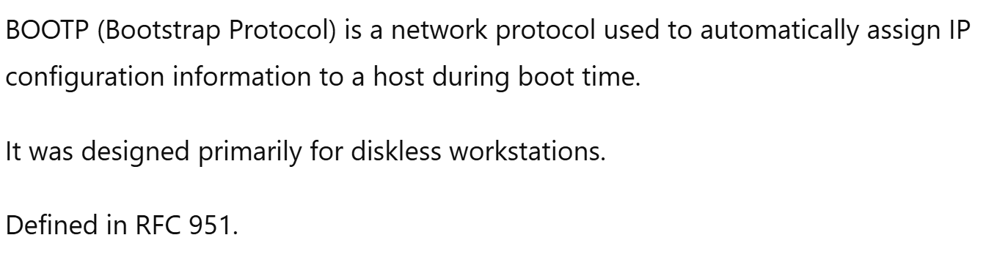
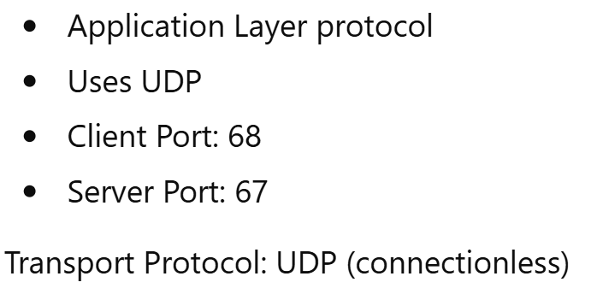
BOOTP

Slide 45
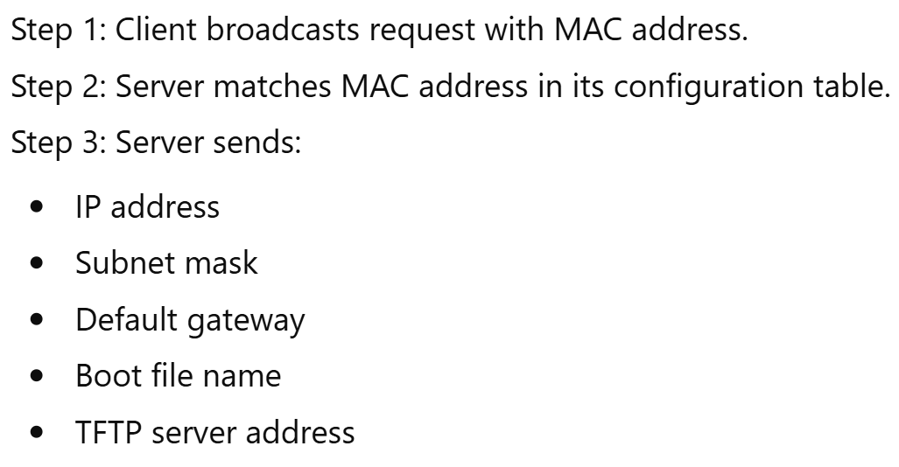
BOOTP Operation in Detail
Trivial File Transfer Protocol

Slide 46
BootP

Slide 47
